Slide 1
C++ Programming:
From Problem Analysis to Program Design, Fourth Edition
Chapter 9: Arrays and Strings

Slide 2
Objectives
In this chapter, you will:
Learn about arrays
Explore how to declare and manipulate data into arrays
Understand the meaning of “array index out of bounds”
Become familiar with the restrictions on array processing
Discover how to pass an array as a parameter to a function
C++ Programming: From Problem Analysis to Program Design, Fourth Edition

Slide 3
Objectives (continued)
Discover how to manipulate data in a two-dimensional array
C++ Programming: From Problem Analysis to Program Design, Fourth Edition

Slide 4
Data Types
A data type is called simple if variables of that type can store only one value at a time
A structured data type is one in which each data item is a collection of other data items
C++ Programming: From Problem Analysis to Program Design, Fourth Edition

Slide 5
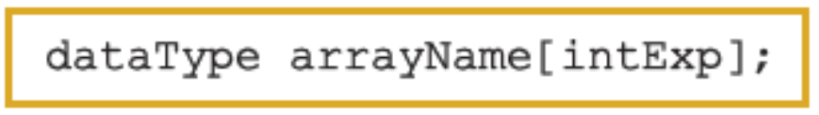
Arrays
Array: a collection of a fixed number of components wherein all of the components have the same data type
In a one-dimensional array, the components are arranged in a list form
Syntax for declaring a one-dimensional array:
intExp evaluates to a positive integer
C++ Programming: From Problem Analysis to Program Design, Fourth Edition

Slide 6
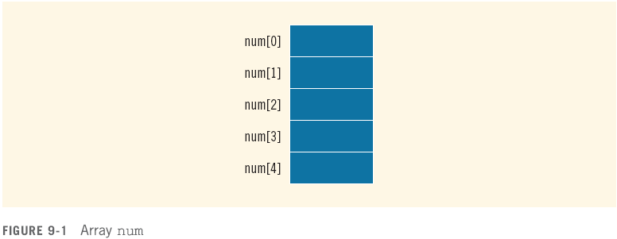
Arrays (continued)
Example:
int num[5];
C++ Programming: From Problem Analysis to Program Design, Fourth Edition

Slide 7
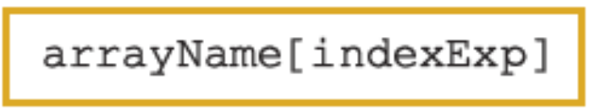
Accessing Array Components
General syntax:
where indexExp, called an index, is any expression whose value is a nonnegative integer
Index value specifies the position of the component in the array
[] is the array subscripting operator
The array index always starts at 0
C++ Programming: From Problem Analysis to Program Design, Fourth Edition

Slide 8

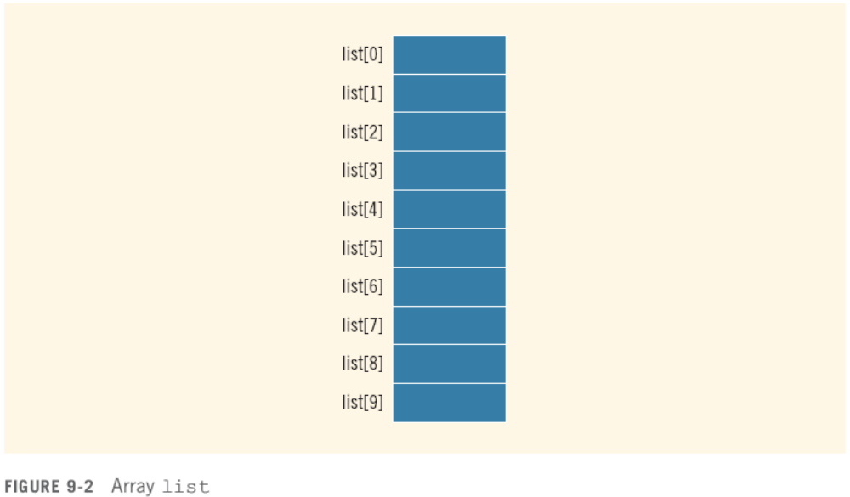
Accessing Array Components (continued)
C++ Programming: From Problem Analysis to Program Design, Fourth Edition

Slide 9

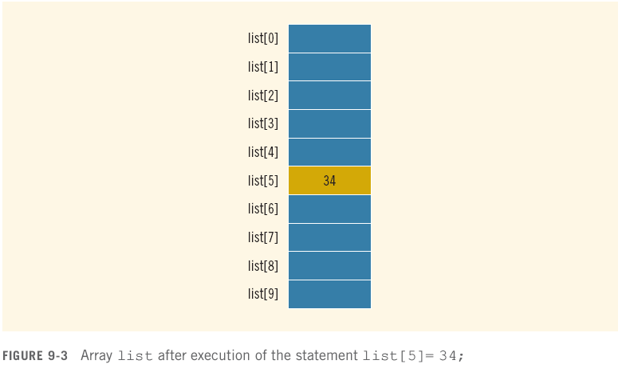
Accessing Array Components (continued)
C++ Programming: From Problem Analysis to Program Design, Fourth Edition

Slide 10
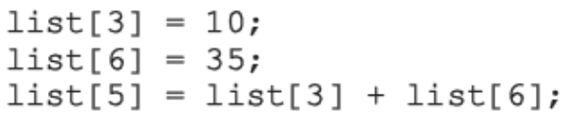
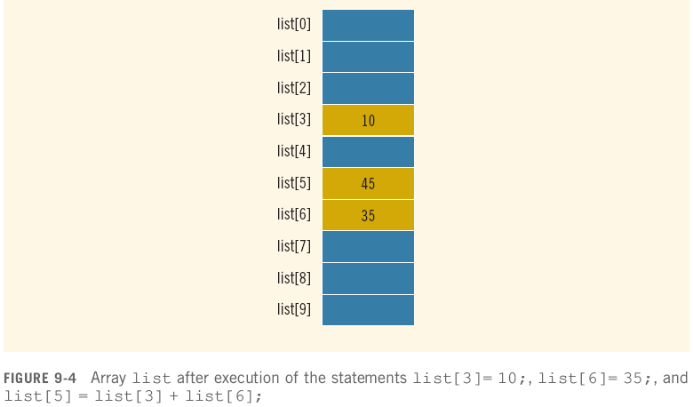
Accessing Array Components (continued)
C++ Programming: From Problem Analysis to Program Design, Fourth Edition

Slide 11
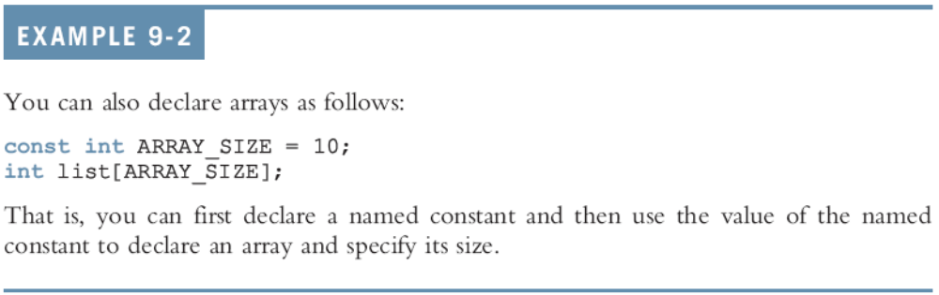
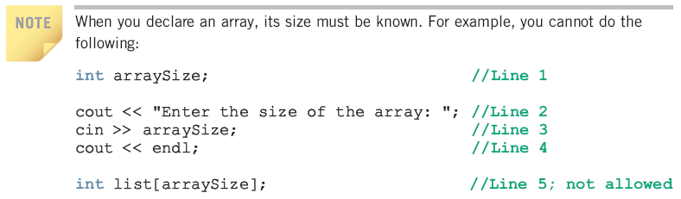
Accessing Array Components (continued)
VLA(s) and Flexible Arrays are supported
by some compilers, Dev C++ one of them
C++ Programming: From Problem Analysis to Program Design, Fourth Edition

Slide 12
Processing One-Dimensional Arrays
Some basic operations performed on a one-dimensional array are:
  Initializing
  Inputting data
  Outputting data stored in an array
  Finding the largest and/or smallest element
Each operation requires ability to step through the elements of the array
Easily accomplished by a loop
C++ Programming: From Problem Analysis to Program Design, Fourth Edition

Slide 13
Processing One-Dimensional Arrays (continued)
Consider the declaration
int list[100]; //array of size 100
int i;
Using for loops to access array elements:
for (i = 0; i < 100; i++) //Line 1
//process list[i] //Line 2
Example:
for (i = 0; i < 100; i++) //Line 1
cin >> list[i]; //Line 2
C++ Programming: From Problem Analysis to Program Design, Fourth Edition

Slide 14
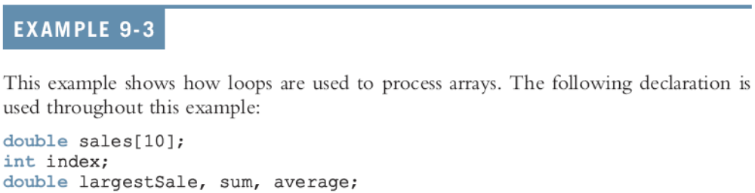





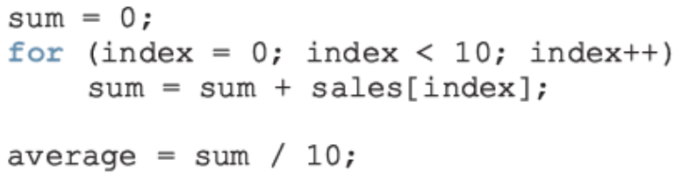
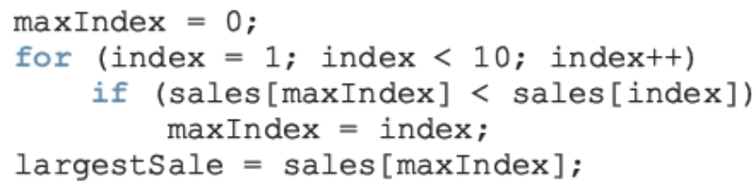

Slide 15
Array Index Out of Bounds
If we have the statements:
double num[10];
int i;
The component num[i] is valid if i = 0, 1, 2, 3, 4, 5, 6, 7, 8, or 9
The index of an array is in bounds if the index >=0 and the index <= ARRAY_SIZE-1
  Otherwise, we say the index is out of bounds
In C++, there is no guard against indices that are out of bounds
C++ Programming: From Problem Analysis to Program Design, Fourth Edition

Slide 16
Array Initialization During Declaration
Arrays can be initialized during declaration
  In this case, it is not necessary to specify the size of the array
    Size determined by the number of initial values in the braces
Example:
double sales[] = {12.25, 32.50, 16.90, 23, 45.68};
C++ Programming: From Problem Analysis to Program Design, Fourth Edition

Slide 17
Partial Initialization of Arrays During Declaration
The statement:
int list[10] = {0};
declares list to be an array of 10 components and initializes all of them to zero
The statement:
int list[10] = {8, 5, 12};
declares list to be an array of 10 components, initializes list[0] to 8, list[1] to 5, list[2] to 12 and all other components are initialized to 0
C++ Programming: From Problem Analysis to Program Design, Fourth Edition

Slide 18
Partial Initialization of Arrays During Declaration (continued)
The statement:
int list[] = {5, 6, 3};
  declares list to be an array of 3 components and initializes list[0] to 5, list[1] to 6, and list[2] to 3
The statement:
int list[25]= {4, 7};
  declares an array of 25 components; initializes list[0] to 4 and list[1] to 7; all other components are initialized to 0
C++ Programming: From Problem Analysis to Program Design, Fourth Edition

Slide 19
Some Restrictions on Array Processing
Consider the following statements:
C++ does not allow aggregate operations on an array:
Solution:
C++ Programming: From Problem Analysis to Program Design, Fourth Edition

Slide 20


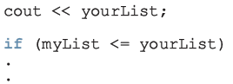
Some Restrictions on Array Processing (continued)
The following is illegal too:
Solution:
The following statements are legal, but do not give the desired results:
C++ Programming: From Problem Analysis to Program Design, Fourth Edition

Slide 21
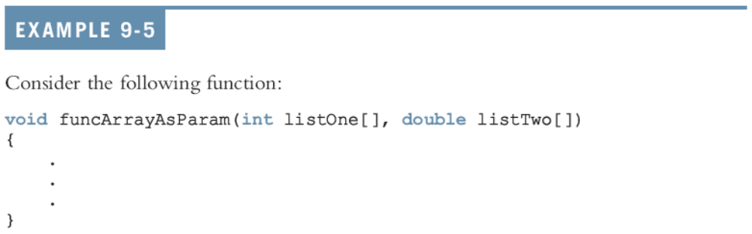
Arrays as Parameters to Functions
Arrays are passed by reference only
The symbol & is not used when declaring an array as a formal parameter
The size of the array is usually omitted
  If provided, it is ignored by the compiler
C++ Programming: From Problem Analysis to Program Design, Fourth Edition

Slide 22
Base Address of an Array and Array in Computer Memory
The base address of an array is the address, or memory location of the first array component
If list is a one-dimensional array, its base address is the address of list[0]
When we pass an array as a parameter, the base address of the actual array is passed to the formal parameter
C++ Programming: From Problem Analysis to Program Design, Fourth Edition

Slide 23
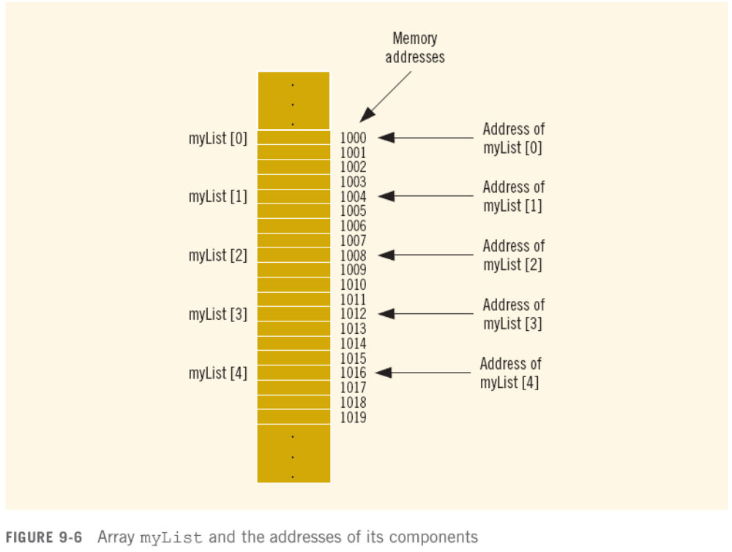

Slide 24
Functions Cannot Return a Value of the Type Array
C++ does not allow functions to return a value of the type array
C++ Programming: From Problem Analysis to Program Design, Fourth Edition

Slide 25

Two-Dimensional Arrays
Two-dimensional array: collection of a fixed number of components (of the same type) arranged in two dimensions
  Sometimes called matrices or tables
Declaration syntax:
  where intexp1 and intexp2 are expressions yielding positive integer values, and specify the number of rows and the number of columns, respectively, in the array
C++ Programming: From Problem Analysis to Program Design, Fourth Edition

Slide 26

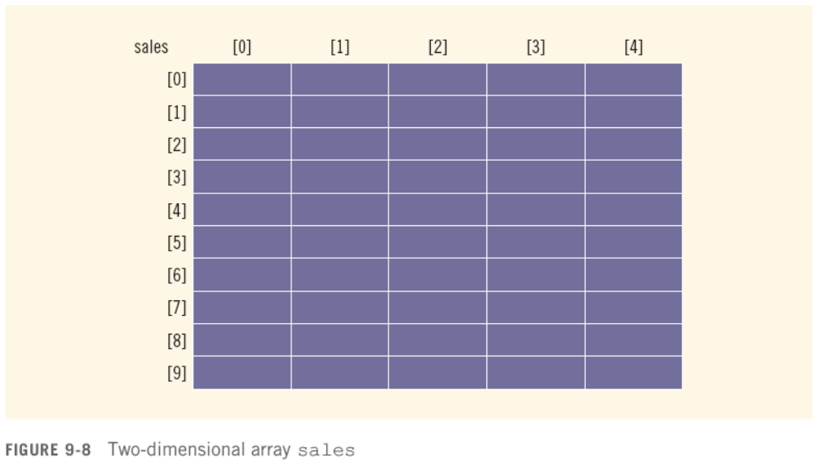
Two-Dimensional Arrays (continued)
C++ Programming: From Problem Analysis to Program Design, Fourth Edition

Slide 27

Accessing Array Components
Syntax:
  where indexexp1 and indexexp2 are expressions yielding nonnegative integer values, and specify the row and column position
C++ Programming: From Problem Analysis to Program Design, Fourth Edition

Slide 28
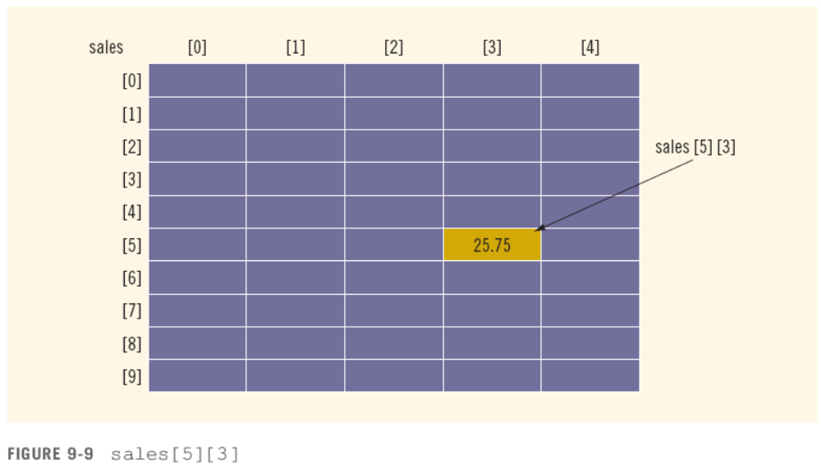
Accessing Array Components (continued)
C++ Programming: From Problem Analysis to Program Design, Fourth Edition

Slide 29

Two-Dimensional Array Initialization During Declaration
Two-dimensional arrays can be initialized when they are declared:
  Elements of each row are enclosed within braces and separated by commas
  All rows are enclosed within braces
  For number arrays, if all components of a row aren’t specified, unspecified ones are set to 0
C++ Programming: From Problem Analysis to Program Design, Fourth Edition

Slide 30
Processing Two-Dimensional Arrays
Ways to process a two-dimensional array:
  Process the entire array
  Process a particular row of the array, called row processing
  Process a particular column of the array, called column processing
Each row and each column of a two-dimensional array is a one-dimensional array
  To process, use algorithms similar to processing one-dimensional arrays
C++ Programming: From Problem Analysis to Program Design, Fourth Edition

Slide 31
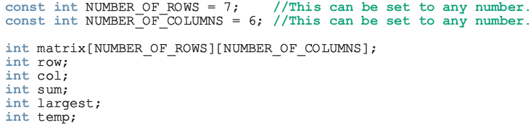
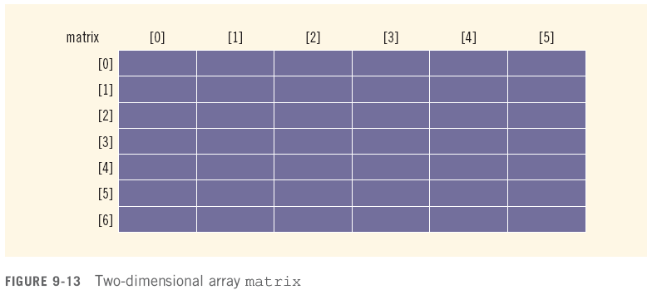
Processing Two-Dimensional Arrays (continued)
C++ Programming: From Problem Analysis to Program Design, Fourth Edition

Slide 32
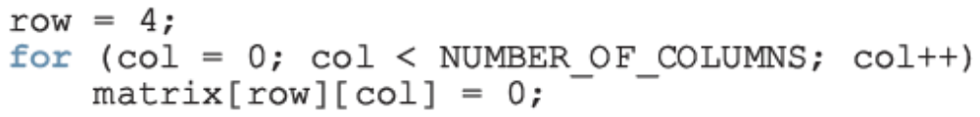

Initialization
To initialize row number 4 (i.e., fifth row) to 0
To initialize the entire matrix to 0:
C++ Programming: From Problem Analysis to Program Design, Fourth Edition

Slide 33
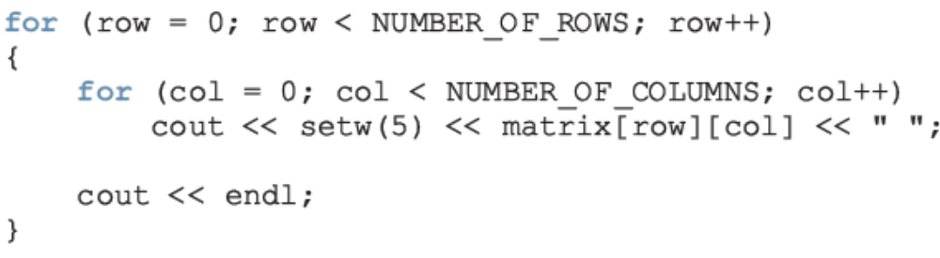
Print
To output the components of matrix:
C++ Programming: From Problem Analysis to Program Design, Fourth Edition

Slide 34
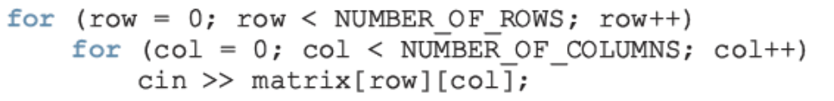
Input
To input data into each component of matrix:
C++ Programming: From Problem Analysis to Program Design, Fourth Edition

Slide 35
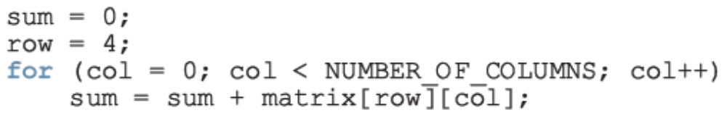
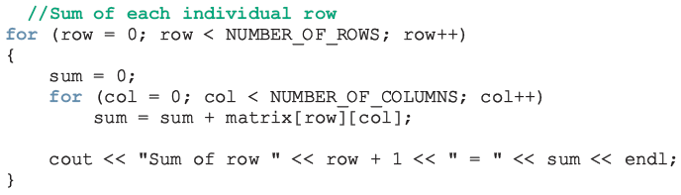
Sum by Row
To find the sum of row number 4 of matrix:
To find the sum of each individual row:
C++ Programming: From Problem Analysis to Program Design, Fourth Edition

Slide 36
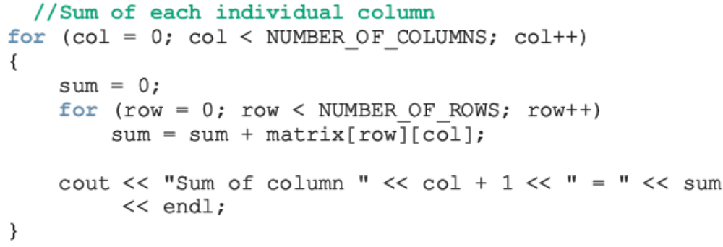
Sum by Column
To find the sum of each individual column:
C++ Programming: From Problem Analysis to Program Design, Fourth Edition

Slide 37
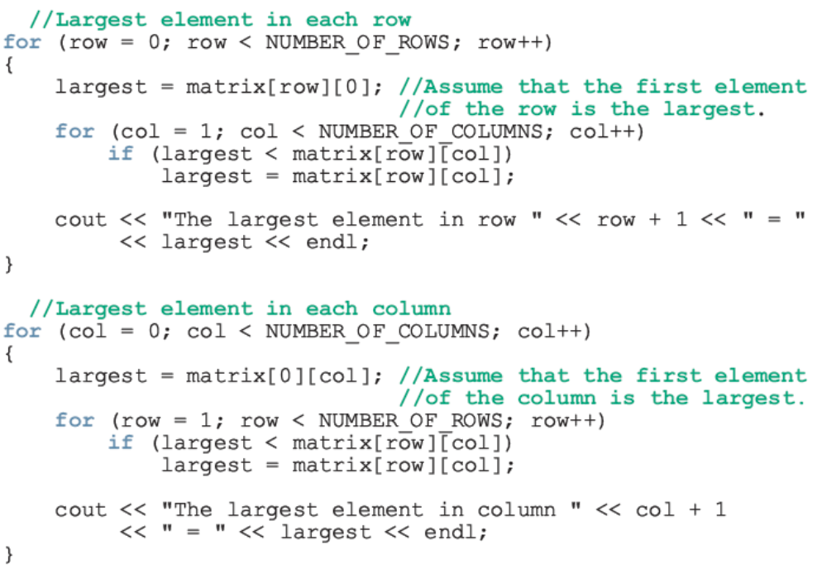
Largest Element in Each Row and Each Column
C++ Programming: From Problem Analysis to Program Design, Fourth Edition

Slide 38
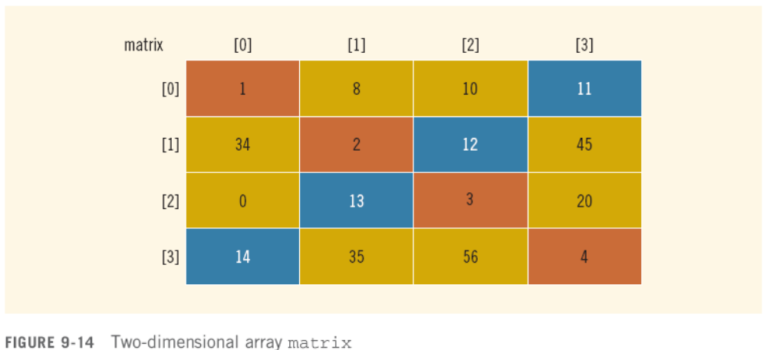
Reversing Diagonal
Before:
C++ Programming: From Problem Analysis to Program Design, Fourth Edition

Slide 39
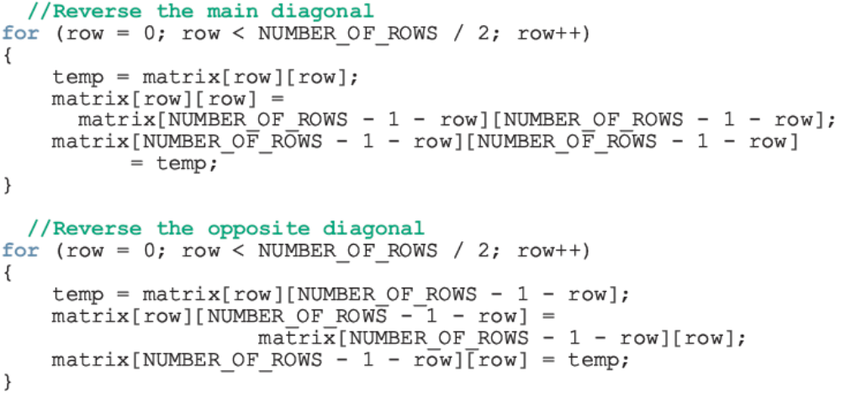
Reversing Diagonal (continued)
To reverse both the diagonals:
C++ Programming: From Problem Analysis to Program Design, Fourth Edition

Slide 40
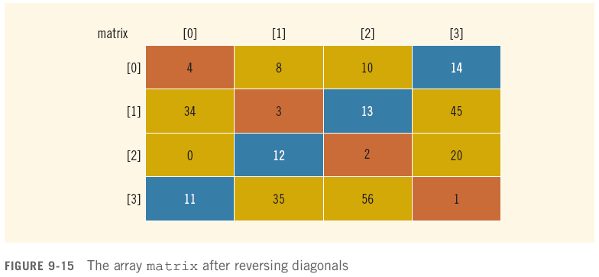
Reversing Diagonal (continued)
After:
C++ Programming: From Problem Analysis to Program Design, Fourth Edition

Slide 41
Summary
Array: structured data type with a fixed number of components of the same type
  Components are accessed using their relative positions in the array
Elements of a one-dimensional array are arranged in the form of a list
An array index can be any expression that evaluates to a nonnegative integer
  Must always be less than the size of the array
C++ Programming: From Problem Analysis to Program Design, Fourth Edition

Slide 42
Summary (continued)
The base address of an array is the address of the first array component
When passing an array as an actual parameter, you use only its name
  Passed by reference only
A function cannot return a value of the type array
C++ Programming: From Problem Analysis to Program Design, Fourth Edition

Slide 43
Summary (continued)
In a two-dimensional array, the elements are arranged in a table form
C++ Programming: From Problem Analysis to Program Design, Fourth Edition

Slide 44
Summary
To access an element of a two-dimensional array, you need a pair of indices:
  One for the row position
  One for the column position
In row processing, a two-dimensional array is processed one row at a time
In column processing, a two-dimensional array is processed one column at a time
C++ Programming: From Problem Analysis to Program Design, Fourth Edition

